Slide 1
Bluetooth controllable rc-vehicle
Anssi Tenhunen, Sara Korento, Juuso Kivijakola, Jussi Vaara

Slide 2
The idea: RC-car that is controlled with android phone via bluetooth connection
Two separately controlled dc-motors attached to the front wheels and one caster tire as a rear wheel
Simple design to ensure keeping things simple and in control
3-wheeled to make the turning circle radius as small as possible
Bluetooth controlling is done with already existing application made just for the purpose

Slide 3
Designing and building the vehicle
The most trouble was encountered with the pcb design, because no one in our group had notable previous experience in designing them.
After we finally got our board done after 14 different versions, we started 3d-printing parts and carving base structures from wood
Then we soldered components to the board and glued/bolted vehicle parts together
The program still has some bugs

Slide 4
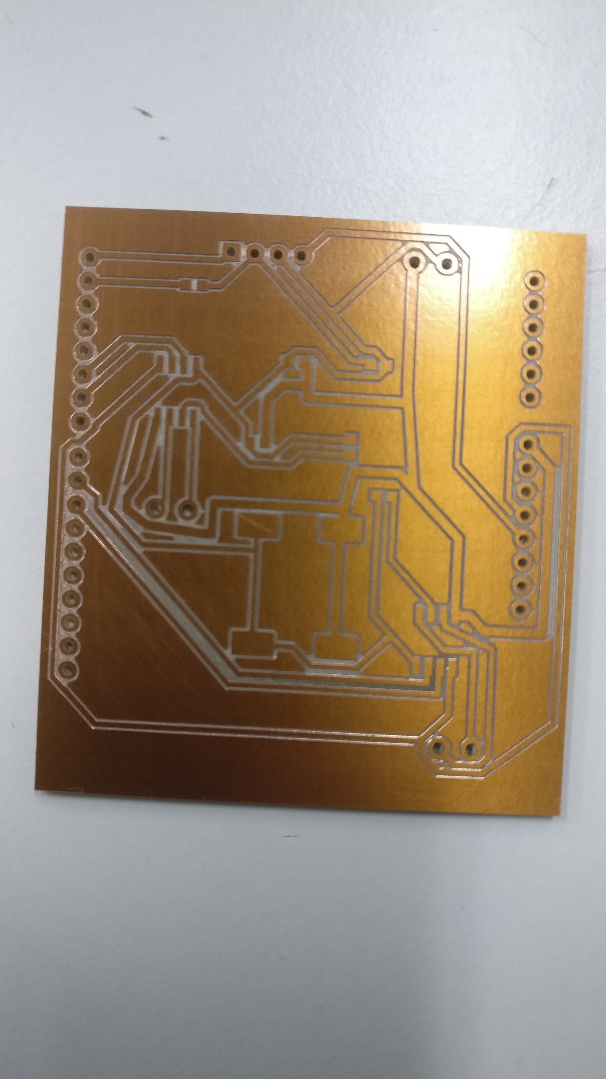

Slide 5
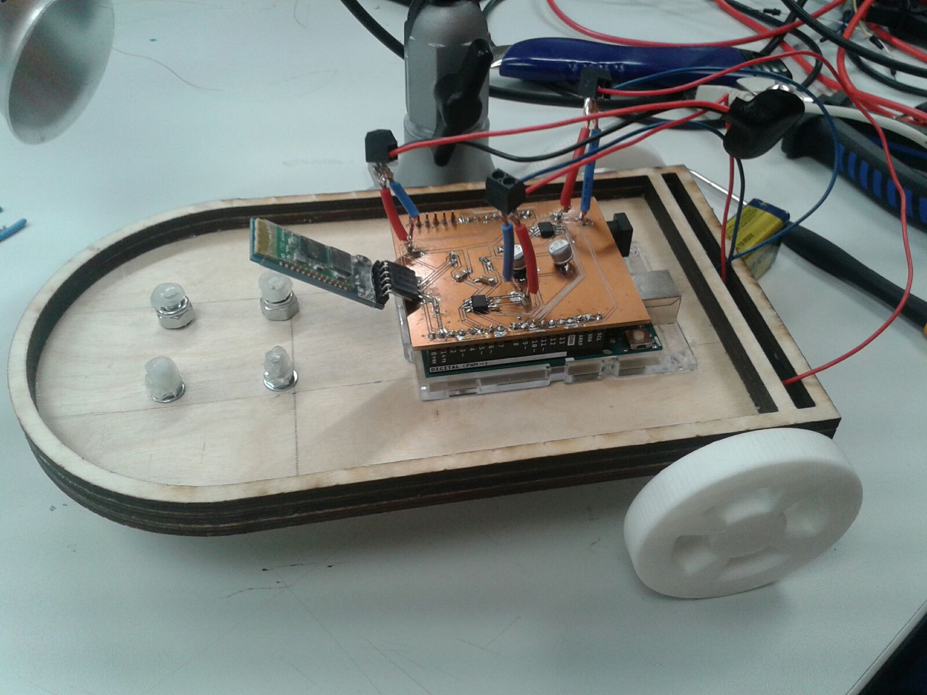

Slide 6
The current state and the future
Every essential part is produced and put to its corresponsive place
Bluetooth connection works
We run out of time with testing and adjusting the final prototype so it needs some more work
We will produce a more car-looking frame
It will either be carved or molded

